Slide 1
7FNCE040W
Business Analytics
Recap from WEEK 1

Slide 2
Now we will use SPSS to conduct the Analysis
FROM DATA FOLDER IN BLACKBOARD SELECT FILE
‘National Insurance.SAV

Slide 3
Sample Problems Frequency Distributions, Descriptive Statistics, Chi-square and t- tests¹
.
Jill Baxter, Vice President of Customer Service for National Insurance Company, and her assistant, Tom Kurtis, want you to develop and briefly discuss the demographic profile of the survey respondents. Please conduct frequencies and cross tabulations on any variables you feel may be of interest to Jill and Tom.
Jill and Tom want to find out National’s average service perception ratings along each of the five dimensions: tangibles, reliability, responsiveness, assurance, and empathy. They also want to know the most and least critical service dimensions, as perceived by the customers. Perform the necessary statistical analyses and report the findings in statistical and managerial terms.
Jill and Tom want to see whether there are significant² relationships between customers’ willingness to recommend National to a friend and the variables listed below. Perform the necessary statistical analyses and report the findings in statistical and managerial terms.
Age
Marital status
Income
Education

Slide 4
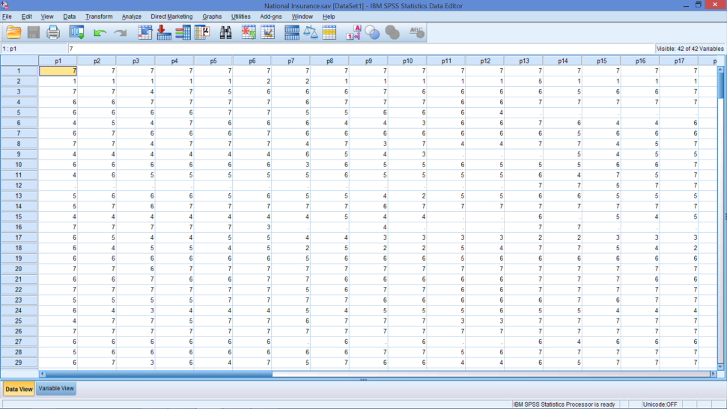
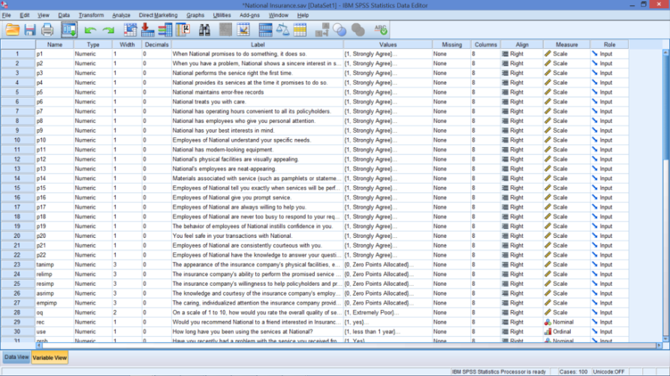
Open SPSS File: National Insurance.SAV
Data View
Variable View
Notes:
Hopefully, the next exercises will convince you that SPSS is superior to Excel.
But, Excel can do a lot of analyses if there are no other options.
While the Data view looks just like the Excel worksheet, the variable view is what makes SPSS user friendly.

Slide 5
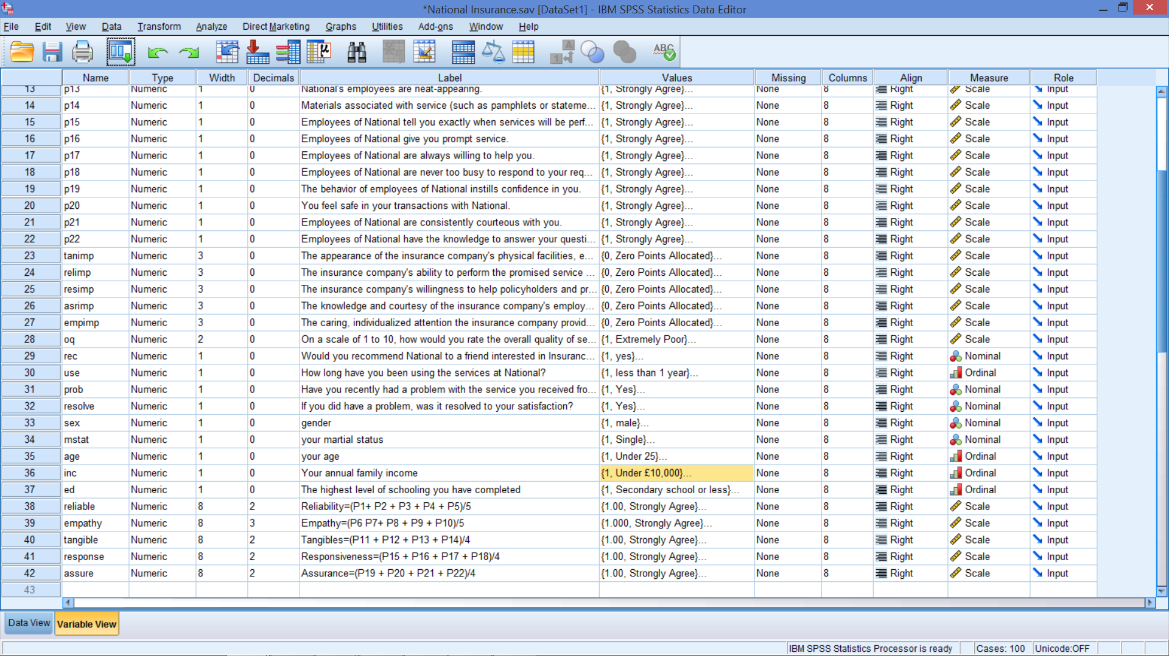
Note Computed Variables 1.tangibles, 2.reliability, 3.responsiveness, 4.assurance, and 5.empathy
Notes:
Computed variables are created by:
Select Transform
Click Compute
Type ‘reliable’ in Target Variables box
Click on parentheses () and move it to the numeric expressions box
Click p1 and move it inside the parentheses in the numeric expressions box
Click on the ‘+’ sign
Click on p2 and move it to the numeric expressions box and then click on the ‘+’ sign
Repeat this for p3, p4, and p5 and then divide the whole expression by 5
Click on Type & Label under the Target Variable box and type Overall Reliability – constructed from the 5 rating scales in the label box
Click OK

Slide 6
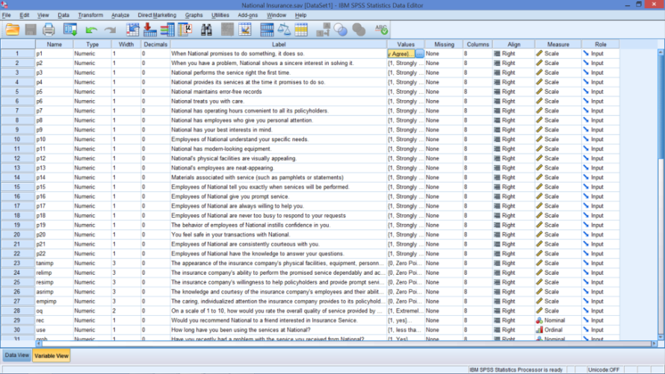
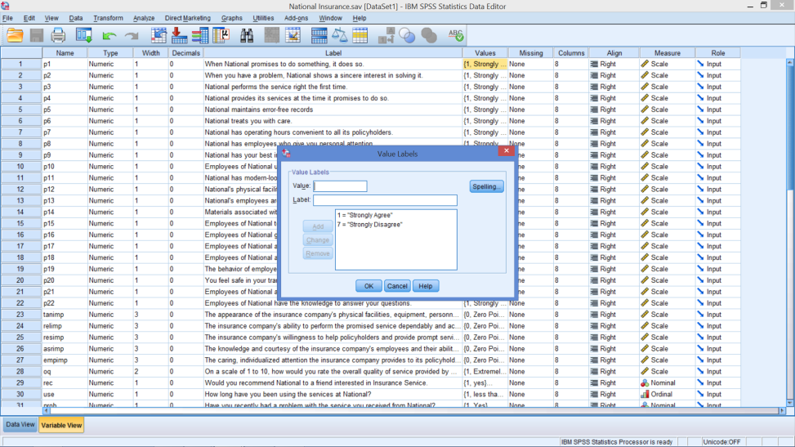
Look at P1 (First Row)
Highlight Value Column
Click on Box with …
Notes:
Looking at the Value column
Can see how responses are coded
Great feature
Also note that there is a missing column.
In this case, missing responses are blank
But, some data files code missing values as 999, for example. This will let SPSS know that these are just place holders and should not be used in any calculations.
Note, too, that there is a column for the type of data
Interval and ratio data are considered Scale data

Slide 7
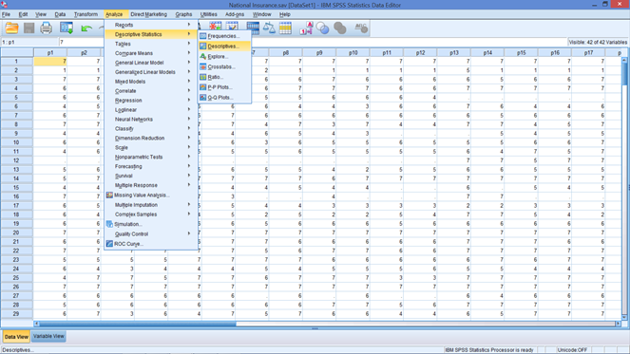
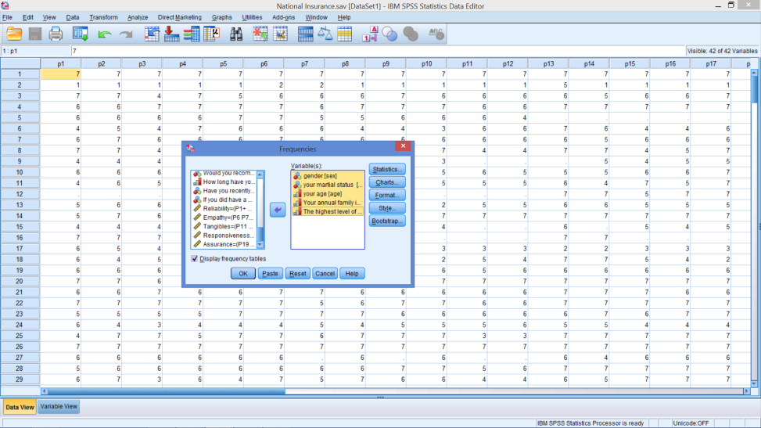
Do Same tasks with SPSS
Analyse → Descriptive Statistics → Frequencies
Select variables gender → education
Notes:
Analyse
Descriptive Statistics
Frequencies
Highlight 5 demographic variables (gender – education)
Click on arrow, moving them to other box

Slide 8
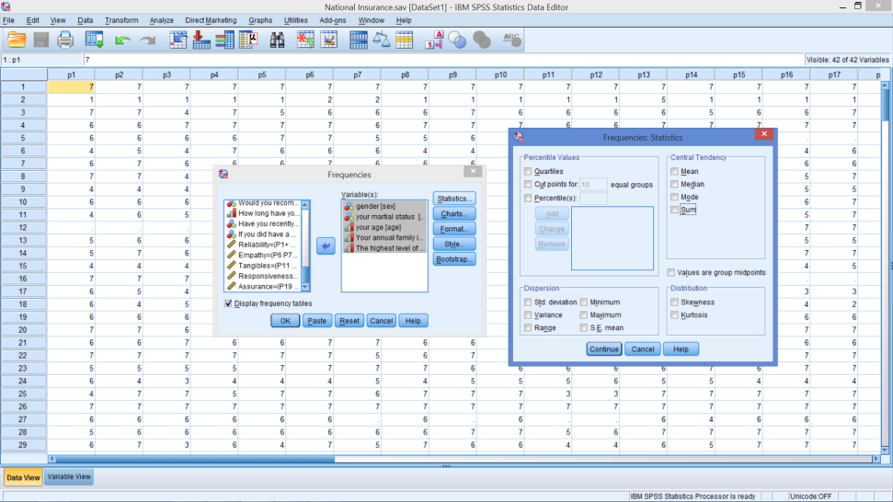
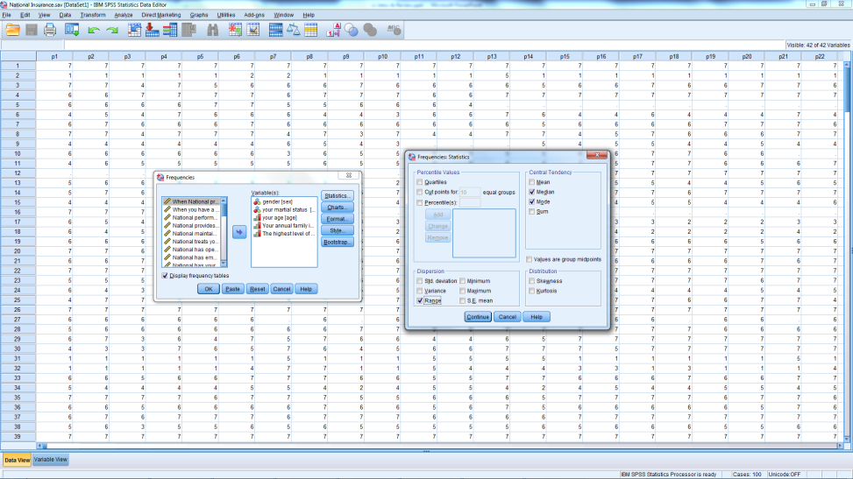
Statistics
From Statistics Box
What do we want? Median, Mode & Range
Then click Continue
Notes:
Check only those that apply to the data given
If you choose all the options, be careful with the output used

Slide 9
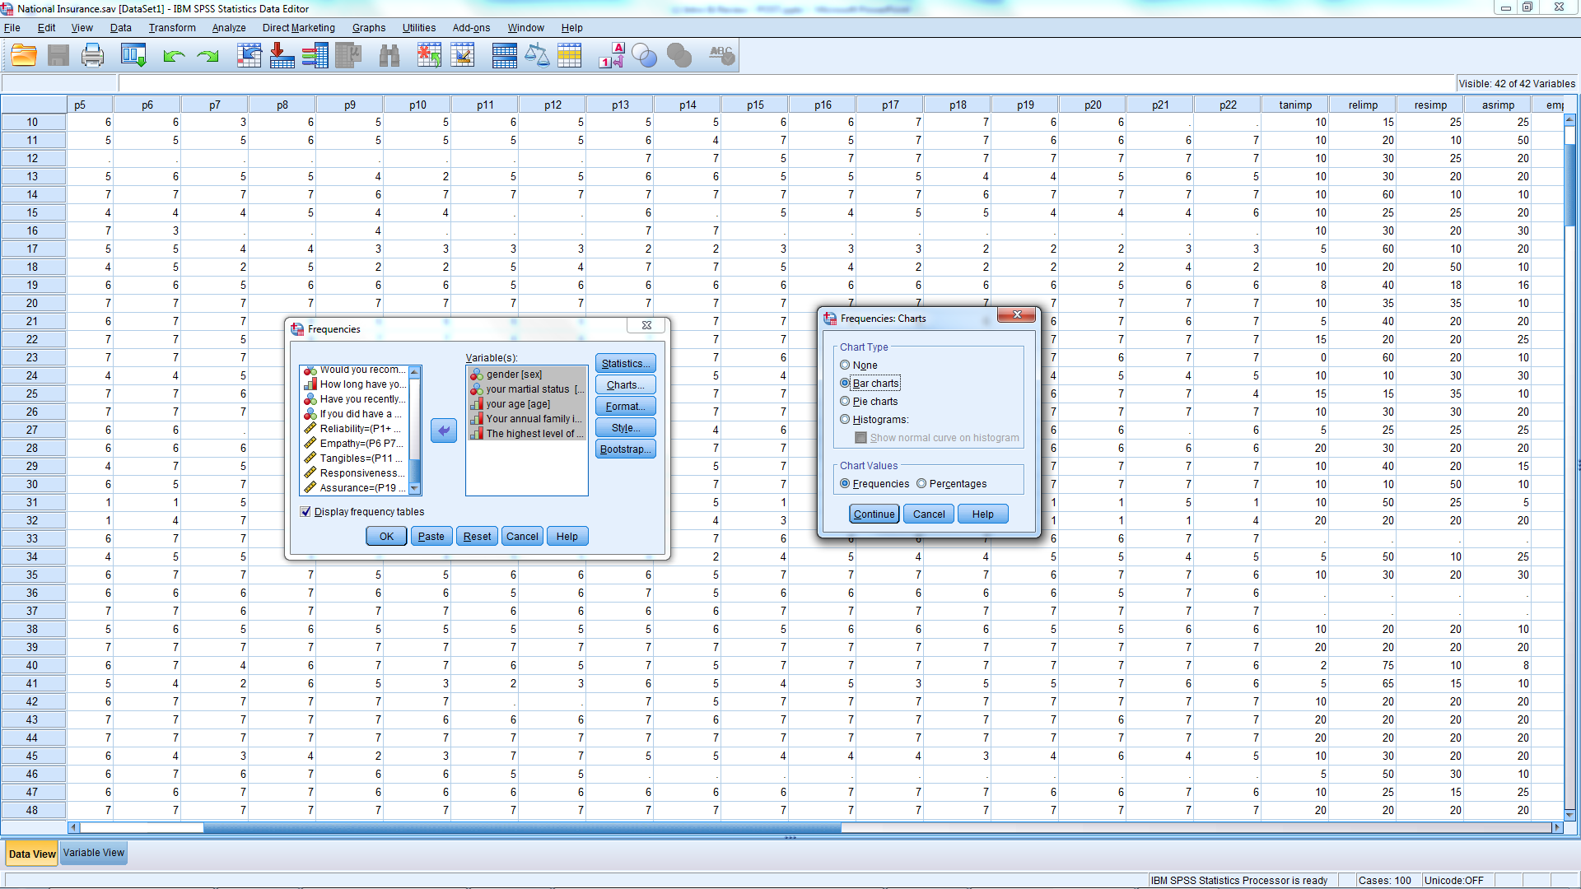
Chart Output-From Charts Select Bar chart & tick ‘Display Frequency table’
Notes:
Select bar chart or histogram
Bar char is preferred because it will use the labels from variable view
Make sure ‘Display Frequency Tables’ is ticked

Slide 10
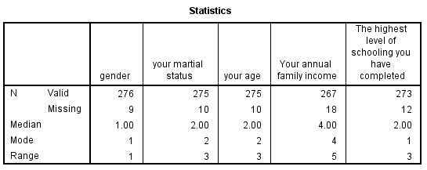
Statistics
What do these statistics mean?
Notes:
What is the difference between valid sample and total (286)?
Remember the median and range of nominal data have no meaning!

Slide 11
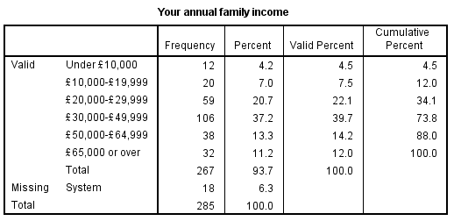
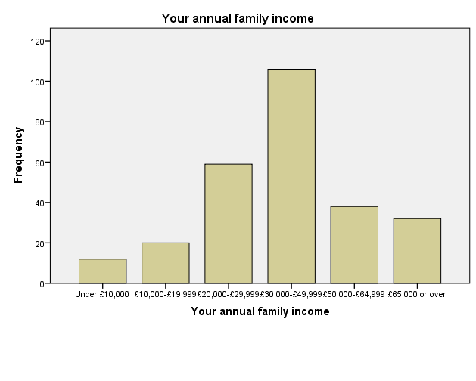
Income- If you do the same for the income data you should get the results below
Statistics
Frequency Chart

Slide 12
Questions to Answer
What percentage of sample are women?
What percentage have been with National for 2 years or more? (See column 30)
What is the distribution of quality of service? (See column 28)
What percentage rate overall quality of service at 5 or greater?
What are the mean and variance of quality of service?
Is there a difference between men & women on perceptions of service quality?
1
2
3
4
5
6

Slide 13
Gender What percentage of sample are women?
Statistics
Chart
Notes:
Insert your output into this slide, if you want, then save it to your own drive.
What percentage of sample are women?
47.8%

Slide 14
Questions to Answer
What percentage of sample are women?
What percentage have been with National for 2 years or more? (See column 30)
What is the distribution of quality of service? (See column 28)
What percentage rate overall quality of service at 5 or greater?
What are the mean and variance of quality of service?
Is there a difference between men & women on perceptions of service quality?
1
2
3
4
5
6

Slide 15
Time with Company- What percentage have been with National for 2 years or more? (See column 30)
Statistics
Chart
Notes:
What percentage have been with the company for 2 years or more?
100 – 19.2 = 80.8%

Slide 16
Questions to Answer
What percentage of sample are women?
What percentage have been with National for 2 years or more? (See column 30)
What is the distribution of quality of service? (See column 28)
What percentage rate overall quality of service at 5 or greater?
What are the mean and variance of quality of service?
Is there a difference between men & women on perceptions of service quality?
1
2
3
4
5
6

Slide 17
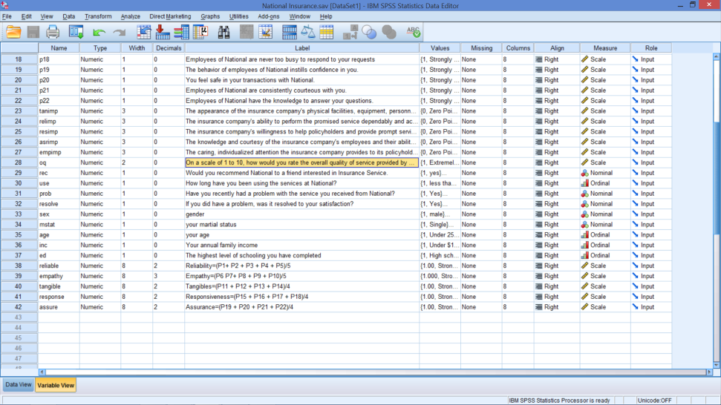
Overall Quality of Service What is the distribution of quality of service? (See column 28)
Variable view – row 28
From Variable View
Scale: 1 - 10
1 = Extremely poor
10 = Extremely good
Run appropriate Descriptive Statistics

Slide 18
Output
Statistics & Frequencies
Chart Output
Notes:
What percentage rate overall quality of service at 5 or greater?
100 – 9.0 = 91.0%
What is the distribution of quality of service?
See chart
What are the mean and variance of quality of service?
Mean: 7.8
Variance: 5.433

Slide 19
Questions to Answer
What percentage of sample are women?
What percentage have been with National for 2 years or more? (See column 30)
What is the distribution of quality of service? (See column 28)
What percentage rate overall quality of service at 5 or greater?
What are the mean and variance of quality of service?
Is there a difference between men & women on perceptions of service quality?
1
2
3
4
5
6

Slide 20
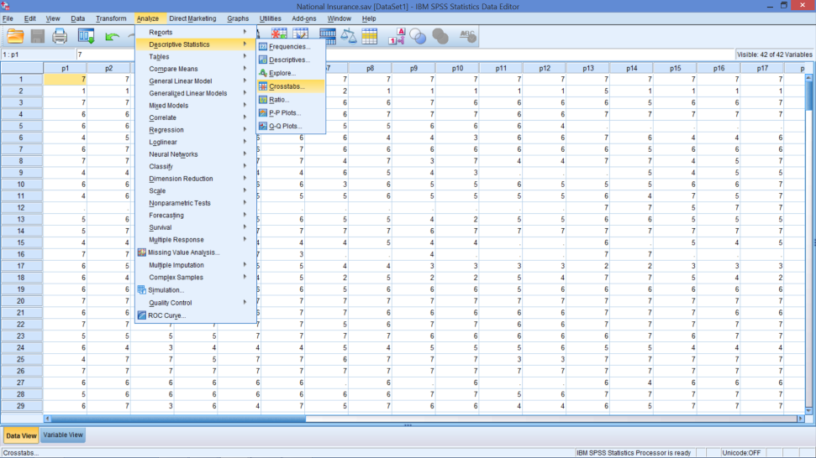
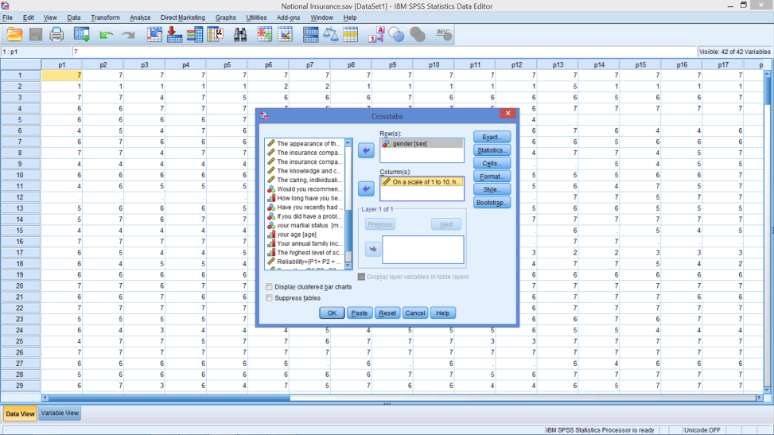
Cross Tabulation Is there a difference between men & women on perceptions of service quality?
Add Two Variables Rows =‘Sex’ Col= ‘On a scale…’
From Descriptive Statistics → Cross Tabs

Slide 21
Crosstabs
Notes:
Why are there 263 responses here, instead of 268 who rated National’s quality of service or 276 who provided their gender?

Slide 22
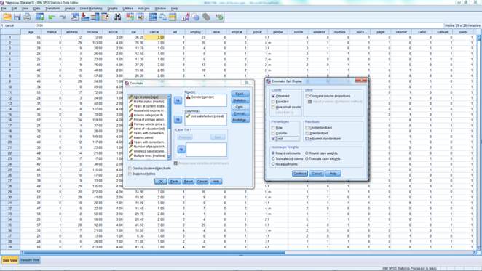
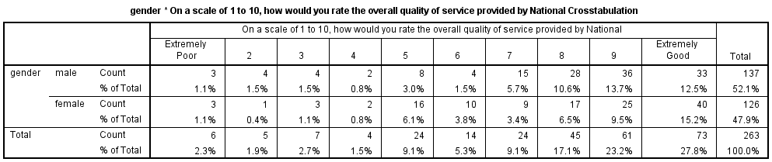
May Want Percentages from cells→ select ‘observed’ & ‘Totals’

